Slide 1





MEDICAL CHATBOT
Presented By THE TRIO’Q

Slide 2

List of Contents
Introduction
Dataset sample
EDA
Swarm Plot
Conclusion
Future Scope
Performance Metrics

Slide 3
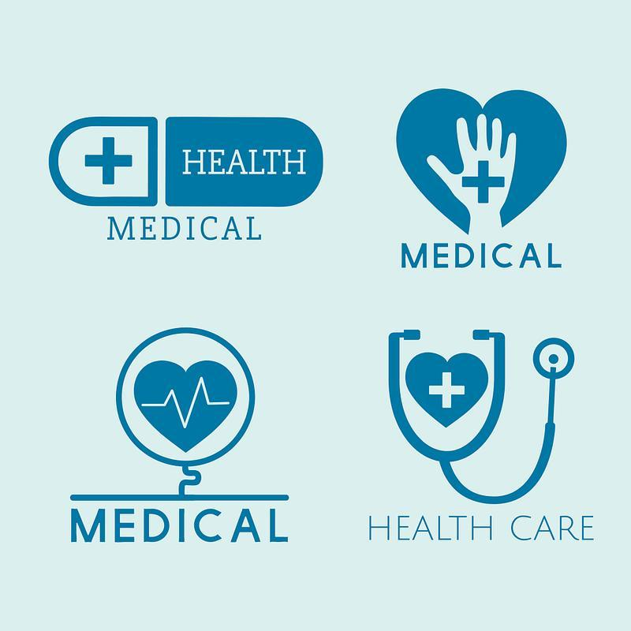




Introduction
The medical chatbot uses natural language processing (NLP)
to quickly and accurately respond to healthcare-related
questions from users.
It is designed to help with common medical issues by
understanding user intents and providing
relevant information, serving as a first-line support tool.

Slide 4

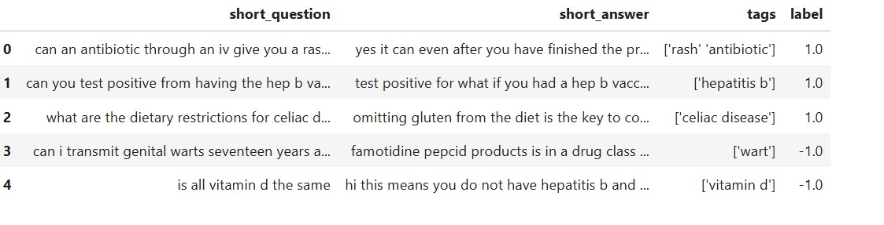
Dataset sample

Slide 5

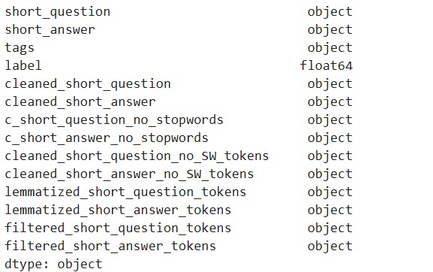
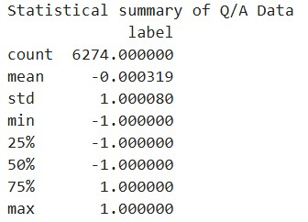
EDA

Slide 6
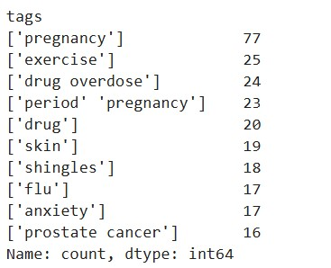
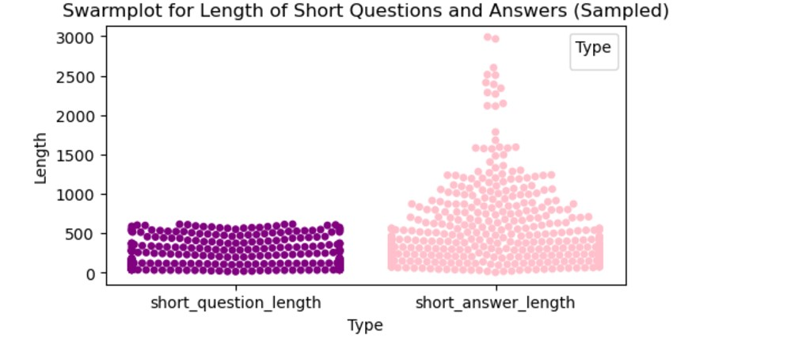

SWARM PLOT

Slide 7
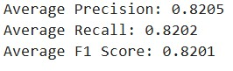
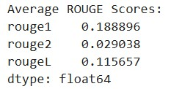
Performance Metrics
BERT Sentence Transformer
TF-IDF

Slide 8

Conclusion
Medical chatbot uses NLP to answer healthcare questions.
Simplifies early medical support access.
Jupyter Notebook includes code and development details:
---Data processing.
---Model training.
---Interaction setup.

Slide 9

Future Scope:
Personalized Care: Tailor advice using user data and real-time health monitoring.
Telemedicine Integration: Bridge patients and doctors for remote consultations.
Advanced AI: Enable predictive diagnostics and multilingual support.
.
.

Slide 10

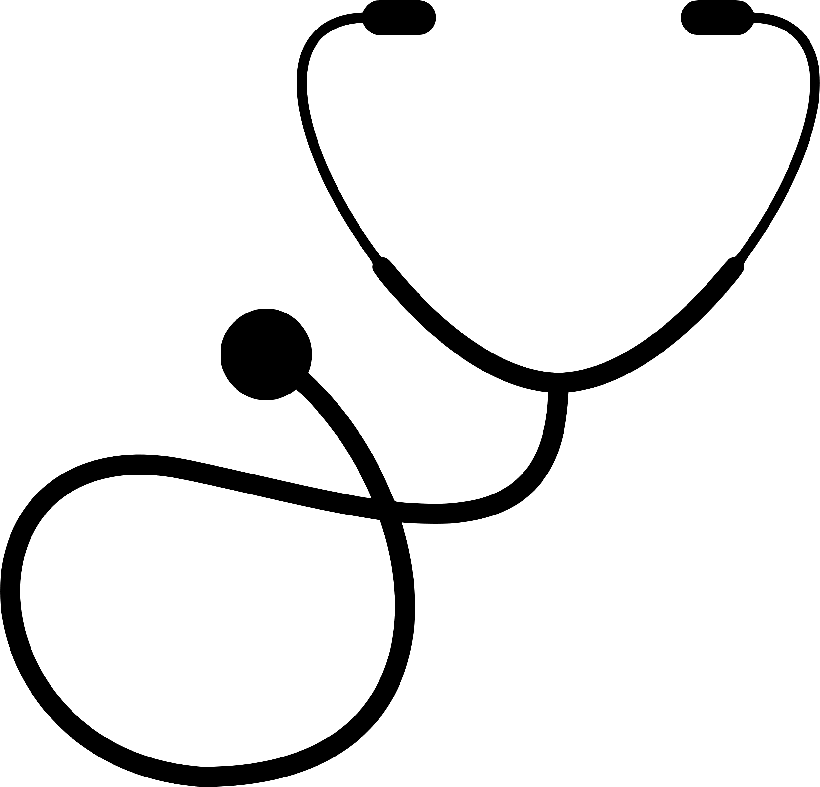
Group Members
Kohina R.K. Bhande
E23CSEU1626
Ishika Tanwar
E23CSEU1636
Jigyasa Patra
E23CSEU1649

Slide 11

THANK YOU!

